Slide 1

Principles of Microeconomics Session 2: Crazy Rich Asians (Consumption 1)
Associate Professor Jonathan Tan
j.tan@ntu.edu.sg

Slide 2


Crazy Rich Asians
In what ways do these people differ?
What do they have in common?
Can ONE economic model describe their choices?

Slide 3


Slide 4
Session outline
Consumer behavior
Utility and indifference curves
Next week:
Budget constraints and budget lines
Bliss! Constrained optimization
Notes:
This session presents a model of consumer choice, explains how we use it to analyze and predict behavior under different conditions.

Slide 5
Consumer behavior
There are three building blocks of the analysis of consumer behavior
Consumer Preferences
Describes how and why people prefer one good to another
Budget Constraints
People have limited incomes that can be spent on one good or another
Interaction between preferences and budget constraint (incomes) → determine the amount and type of goods will be purchased?
What combination of goods will consumers buy to maximize their utility (satisfaction)?
Notes:
8

Slide 6
Preferences, bundles, utility
Preferences: a description of how much one prefers one good to others
We start with a simple of preferences between two goods
Bundles or baskets: a combination of two (or more) goods or items
Apples and oranges
Food and clothes
Books and pizza
Utility: the amount of satisfaction one gets from consuming a certain combination of goods
Different basket derive different levels of utility
Rational consumers choose the (feasible) basket that yields the highest utility

Slide 7





Consumer preferences
How might a consumer compare different combinations of items (“baskets” or “bundles”) available for purchase?
Individuals can choose between baskets of goods, yielding them respective levels of satisfaction (“utility”)
For simplicity, we will consider only clothes (C) and food (F)
Notes:
10

Slide 8
@u: Food for thought
If you had $100 to spend today, and you could choose between spending it on food or clothes
Would you spend it all on food?
Would you spend it all on clothes?
Would you spend some on food and the rest on clothes? How much?
What are the different considerations you would have when making this consumption choice?
What is your objective when making this choice?

Slide 9
Basic assumptions of preferences
Preferences are complete.
Consumers can rank baskets of goods (A and B) → consumer prefers A to B, or B to A, or indifferent between A and B → only one is true.
Preferences are transitive.
If consumer prefers A to B, and B to C, then A must be preferred to C
Consumers always prefer more of any good to less (nonsatiation).
More is better
Notes:
11

Slide 10

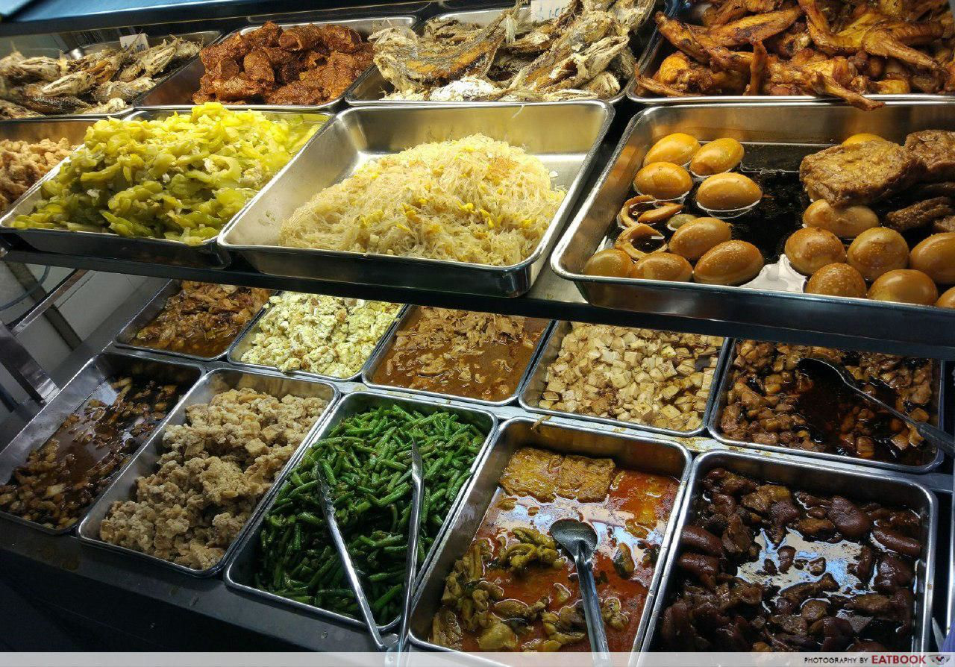
Food for thought
You are at an “economy rice” stall:
3 meat 0 veg?
2 meat 1 veg?
1 meat 2 veg?
0 meat 3 veg?
Would a regular diner prefer 1 meat 1 veg to
2 meat 2 veg?
3 meat 3 veg?
How can we graphically describe such preferences?

Slide 11
Consumer preferences can be represented graphically using indifference curves.
Indifference curves represent all combinations of market baskets that the person is indifferent → the person will be equally satisfied with any one → same level of utility.
Clothing
50
The consumer prefers
A to all combinations
in the yellow box, while
all those in the pink
box are preferred to A.
B
40
H
E
30
A
20
D
G
10
10
20
30
40
Food
Notes:
15

Slide 12
Why we need indifference curves
12
Points such as B & D have more of one good but less of another compared to A
We need more information about consumer ranking to compare utility
For example: Consumer may be indifferent between B, A and D
We can then connect those points with an indifference curve

Slide 13
Indifference curves describe preferences
Graph the points with one good on the x-axis and one good on the y-axis
Plotting the points we can make some immediate observations about preferences
→ more is better and always preferred: B > H > G; E > A
How about A vs B vs D?
See next slide for graph
Market Basket | Units of Food | Units of Clothing
A | 20 | 30
B | 10 | 50
D | 40 | 20
E | 30 | 40
G | 10 | 20
H | 10 | 40

Slide 14
Indifference curves: some examples
50
U₁ (Ann) indifferent between B, A, & D
@u: How about U₂ (Bob)?
E is preferred to any basket on U₁
Any basket on U₁ is preferred to H & G
Clothing
B
40
H
E
30
A
20
D
G
U₁
10
U₂
10
20
30
40
Food
Notes:
17

Slide 15
Indifference curves: more is better
15
Clothing
The set of baskets (bundles)
that is preferred.
B
E
A
I(x’)
H
D
U1
Food

Slide 16
To describe preferences for all combinations of goods/services, we have a set of indifference curves – an indifference map – each curve represents a different level of utility
Each indifference curve in the map shows the baskets between which one is indifferent
The higher the indifference curve the more utility consumption it yields the consumer
Clothing
D
B
A
C
U₃
U₂
U₁
Food

Slide 17
Interpreting indifference curves
The shapes of indifference curves describes how much of a good a consumer is willing to give up in exchange for one unit of another
A to B, give up 6 clothing to get 1 food
D to E, give up 2 clothing to get 1 food
The more clothing and less food a person has, the more clothing they will give up to get more food

Slide 18
Interpreting indifference curves
A
Clothing
16
14
Observation: The amount
of clothing given up for
1 unit of food decreases
from 6 to 1 as one has more food and less clothes
12
-6
10
B
1
8
-4
D
6
1
-2
E
4
G
1
-1
2
1
Food
1
2
3
4
5
Notes:
32

Slide 19
Marginal Rate of Substitution
We measure how a person trades one good for another using the marginal rate of substitution (MRS)
It quantifies the amount of one good a consumer will give up to obtain more of another good.
It is measured by the slope of the indifference curve.
Terminology: The MRS of food F for clothing C is the amount of clothing that a person is willing to give up to obtain one additional unit of food
Notes:
29

Slide 20
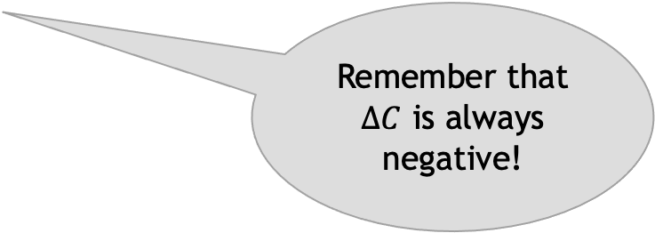
Marginal Rate of Substitution
Clothing
16
A
14
MRS = 6
12
-6
10
B
1
8
-4
D
Remember that $∆C$ is always negative!
6
MRS = 2
1
-2
E
4
G
1
-1
2
1
Food
1
2
3
4
5
Notes:
32

Slide 21
Shape of indifference curves
Indifference curves are (usually) convex
As more of one good is consumed, a consumer would prefer to give up fewer units of a second good to get additional units of the first one.
Convexity also means that mixtures of baskets (bundles) are preferred to the bundles themselves
MRS diminishes as we move down along the indifference curve → diminishing marginal rate of substitution.
Notes:
34

Slide 22
Indifference curves cannot cross
If they cross → we violate the assumption of transitivity (if a>b and b>c then a>c) and nonsatiation (more is better)
U₁
U₂
B is preferred to D
A is indifferent to B & D
B must be indifferent to D but that can’t be if B is preferred to D
Clothing
A
B
U₂
D
U₁
Food
Notes:
26

Slide 23
Nonsatiation: indifference curves should be downward sloping
An upward slope violates the assumption that more is preferred to less
@u: Is this possible? What does it imply if you observe someone making choices like that?
50
One would be indifferent if given more of one “bad”, as long as she is compensated with more of the other “good” (e.g. E vs G)
Yummy food
(“good”)
B
40
H
E
30
A
20
D
G
10
10
20
30
40
Yucky food (“bad”)

Slide 24
Perfect substitutes
Apple
Juice
(glasses)
4
Perfect
Substitutes
U=X+Y
MRS constant
3
2
Examples
U=1+0=1
U=1+2=3
U=2+2=4
1
Orange Juice
(glasses)
0
1
2
3
4
Notes:
38

Slide 25
Perfect complements
Left
Shoes
Perfect
Complements
U=min(X,Y)
4
3
2
Examples
U=min(1,0)=0
U=min(1,2)=1
U=min(2,2)=2
1
0
1
2
3
4
Right Shoes
Notes:
40

Slide 26
Neutral goods
Taylor Swift songs
Neutral goods
U=0X+Y
4
3
2
Examples
U=0*1+1=1
U=0*4+1=1
U=0*1+4=4
1
0
1
2
3
4
Elevator music
Notes:
40

Slide 27
Utility function: formula that assigns a level of utility to baskets
If the utility function is U(F,C) = F + 2C, then a basket with 8 units of food and 3 units of clothing gives a utility of 14 = 8 + 2(3)
Market Basket | Food | Clothing | Utility
A | 8 | 3 | 8 + 2(3) = 14
B | 6 | 4 | 6 + 2(4) = 14
C | 4 | 4 | 4 + 2(4) = 12
This consumer is indifferent between A & B, but prefers both to C
Notes:
104

Slide 28
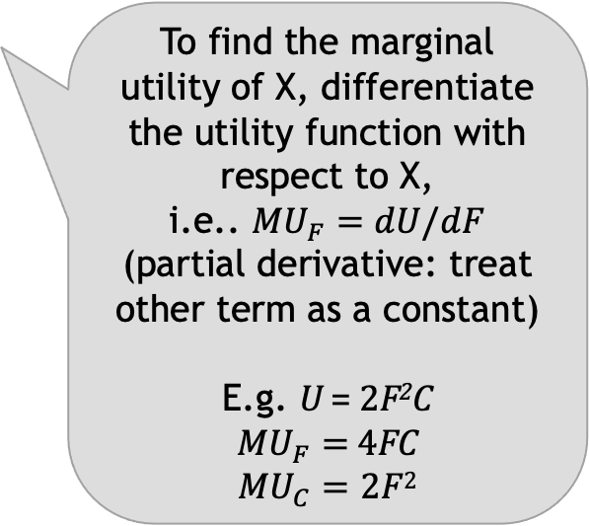
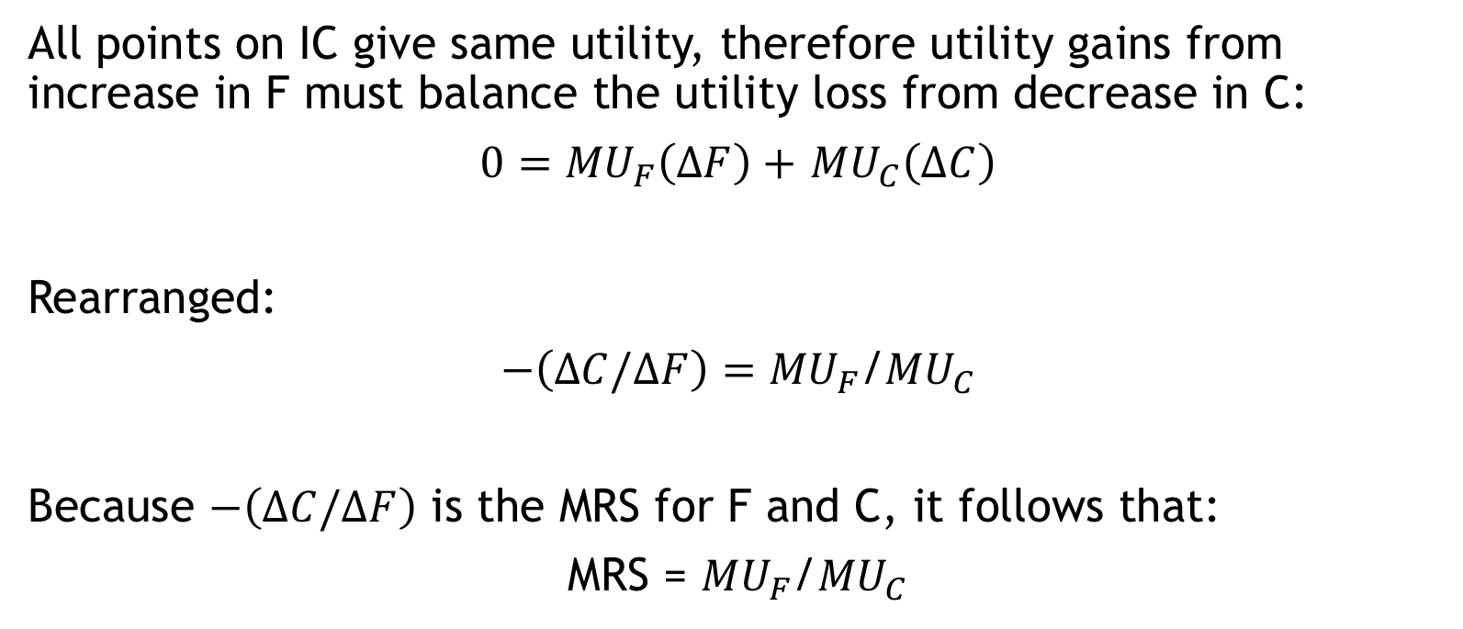
Deriving MRS from utility functions
All points on IC give same utility, therefore utility gains from increase in F must balance the utility loss from decrease in C:
$0={MU}_{F}\left(∆F\right)+$ ${MU}_{C}\left(∆C\right)$
Rearranged:
$−\left(∆C/∆F\right)={MU}_{F}$/${MU}_{C}$
Because $−\left(∆C/∆F\right)$ is the MRS for F and C, it follows that:
MRS = ${MU}_{F}$/${MU}_{C}$
To find the marginal utility of X, differentiate the utility function with respect to X,
i.e.. ${MU}_{F}=dU/dF$
(partial derivative: treat other term as a constant)
E.g. U = 2F²C
${MU}_{F}=$ 4FC
$${MU}_{C}=2F2$$

